Slide 1
Sprint-2 (Phase-1)
By-
Ashwani Sharma
Aryamann Sinha
Ayushi Srivastava
Dixit Agarwal
Ayush Singh
Kshitiz

Slide 2

TALEND OPEN STUDIO
Talend Open Studio is an open-source application developed by Talend, a software that provides big data, data quality, data preparation, and data integration solutions.
In Talend Open Studio, data can be combined easily, converted, and updated in different locations.
Talend open studio supports data integration, big data, ESB, and ETL (extract, transform, load) implementations.

Slide 3
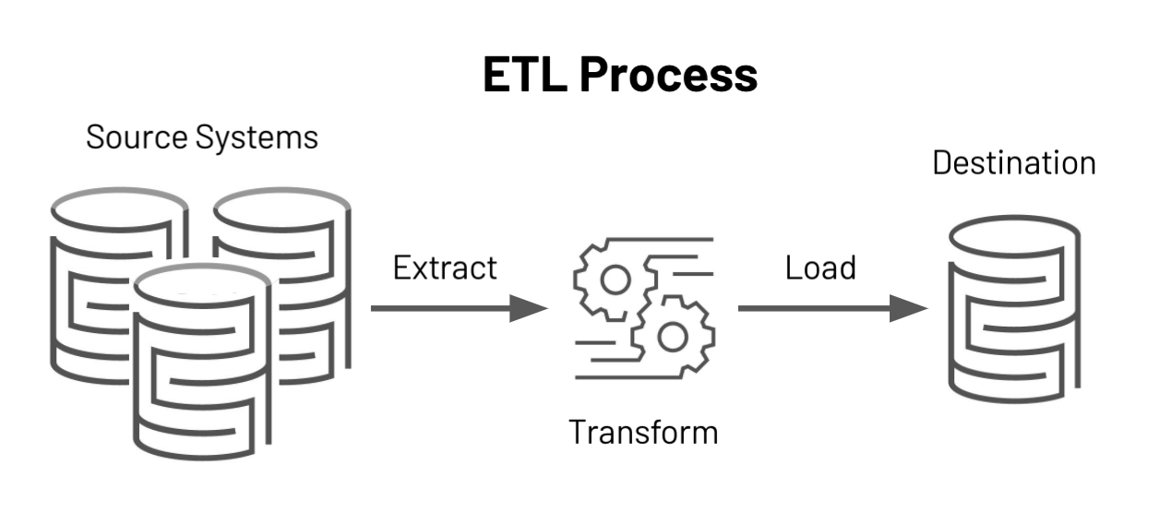
ETL
ETL stands for Extract Transform & Load. The process of updating the data warehouse
ETL is the automated and auditable data acquisition process from source system that involves one or more sub processes of data extraction, data transportation, data transformation, data consolidation, data integration, data loading and data cleaning.
The advantage of having the process of ETL is that data from different sources can be brought together and highly complex and user friendly reports can be generated for decision making.

Slide 4
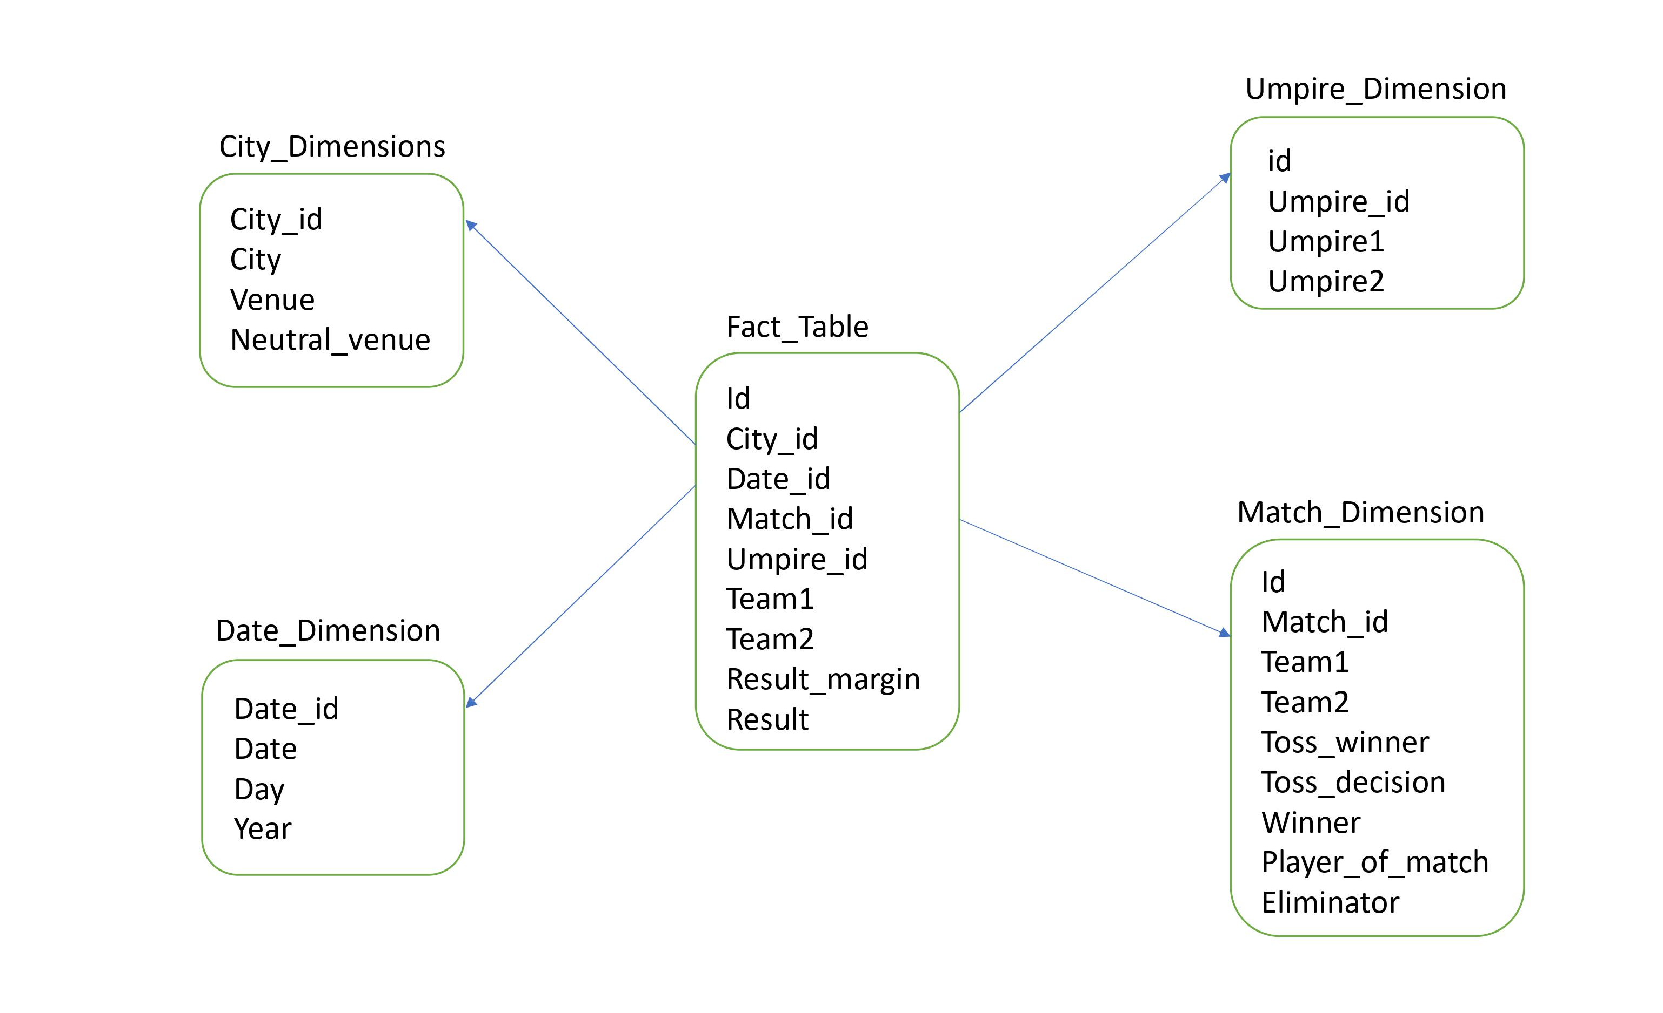
SCHEMA

Slide 5
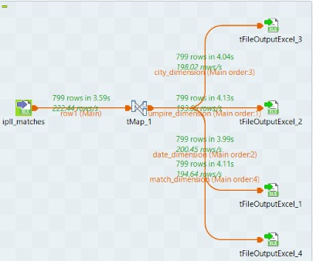
DIMENSION TABLE

Slide 6
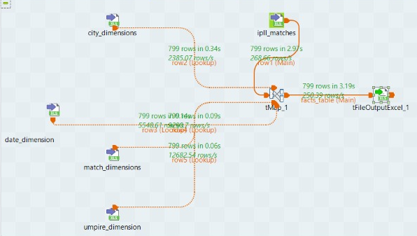
FACT TABLE

Slide 7
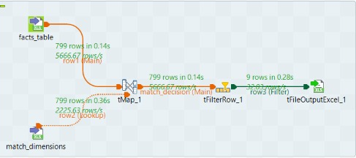
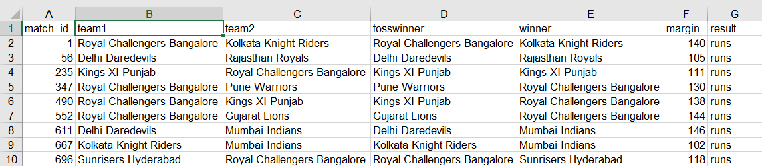
Q- Find the match data in which winning margin is more than 100 runs.
INPUT-
OUTPUT-

Slide 8
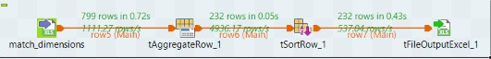
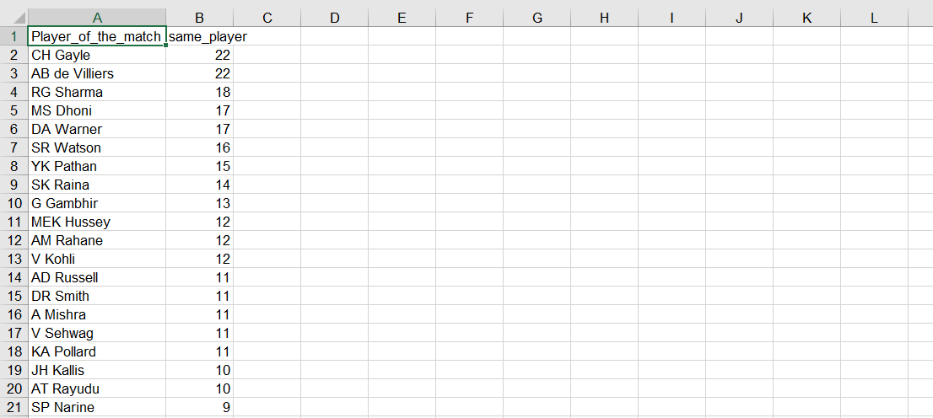
Q-Who has won the most player of the match award.
INPUT-
OUTPUT-

Slide 9
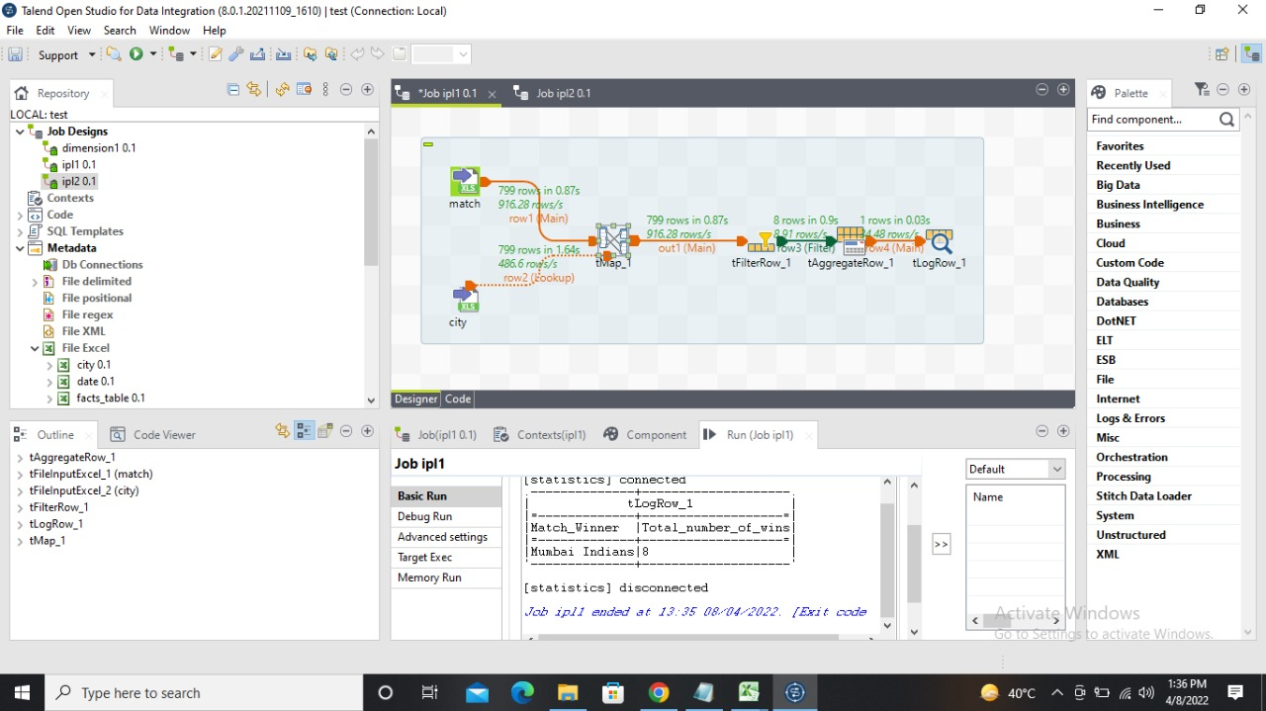
Q-How many match MI has won at Wankhede stadium while chose to bat first.
INPUT-
OUTPUT-

Slide 10
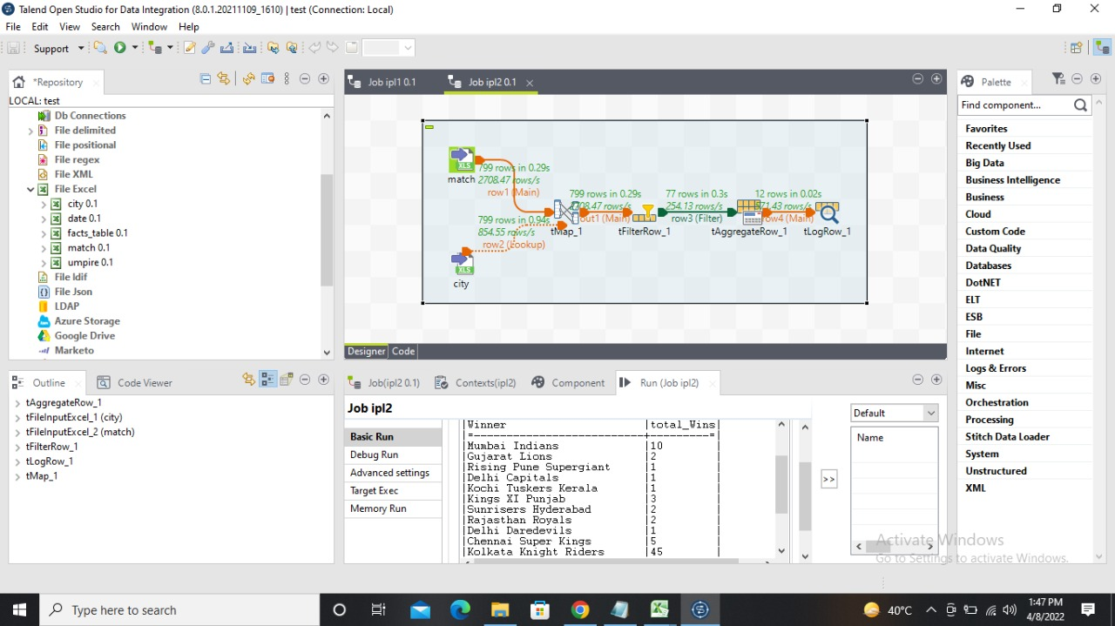
Q-Who has won the most no. of matches at Eden Garden.
INPUT-
OUTPUT-

Slide 11
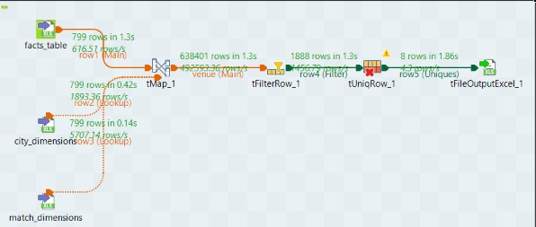
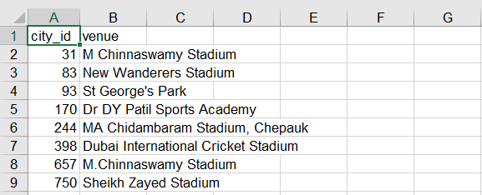
Q-Find out the venue where RCB has beaten MI.
INPUT-
OUTPUT-

Slide 12
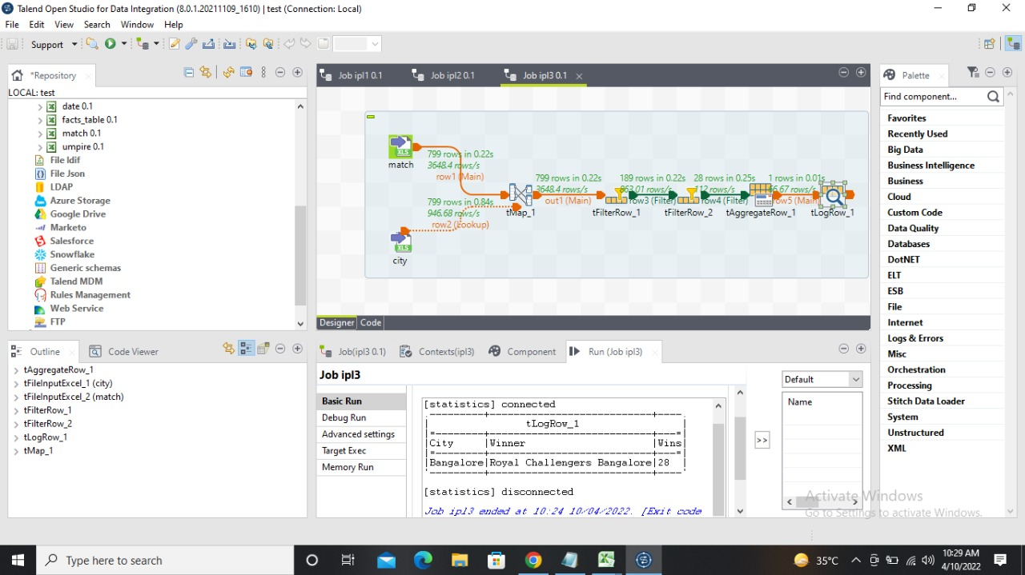
Q-How many matches did RCB played in Bangalore and won?
INPUT-
OUTPUT-

Slide 13
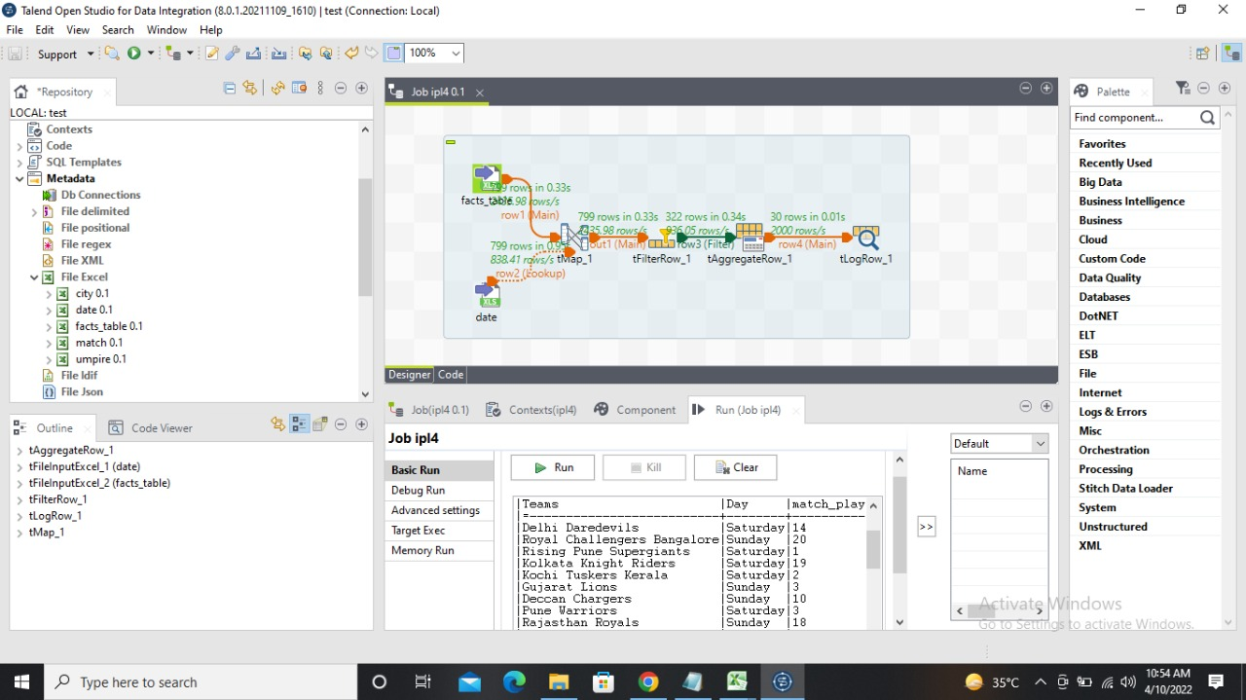
Q-Which team has played most matches on weekends?
INPUT-
OUTPUT-

Slide 14
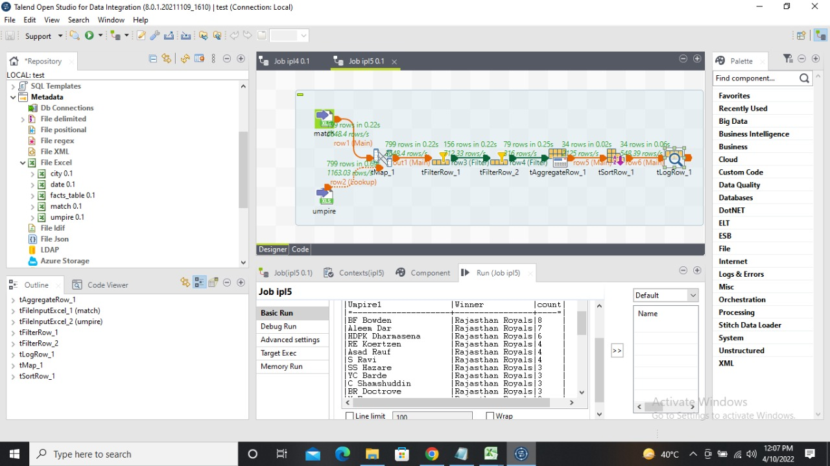
Q-Who was the umpire1 most of the times when RR won the match?
INPUT-
OUTPUT-

Slide 15
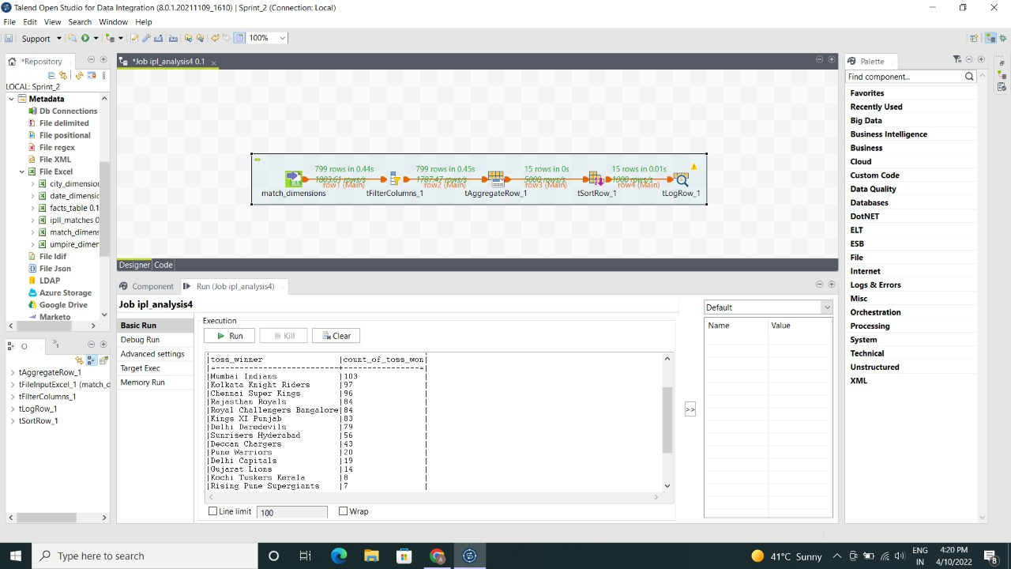
Q-Find the team which won maximum number of tosses.
INPUT-
OUTPUT-

Slide 16
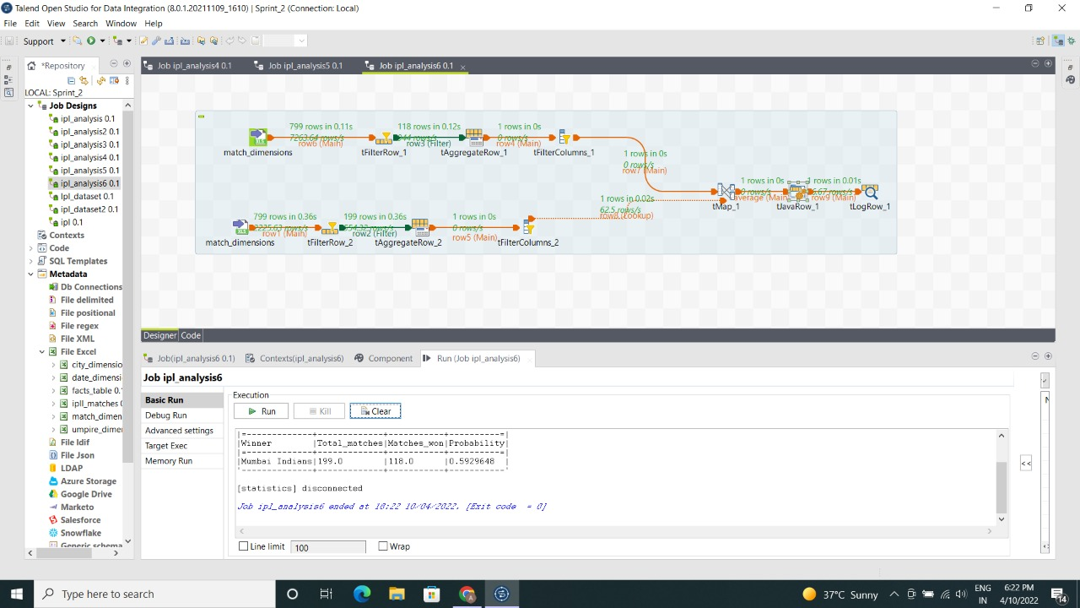
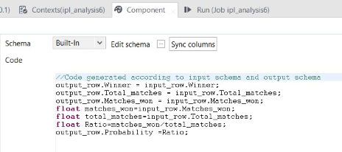
Q-What is the winning probability of Mumbai Indians?
INPUT-
OUTPUT-

Slide 17
THANK YOU

